Slide 1
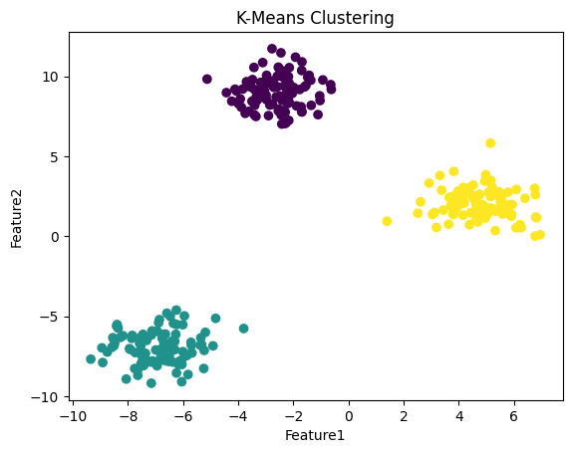
The algorithm works by assigning data points to the nearest cluster centroid.
It iteratively updates centroids until the cluster assignments stabilize.
K-Means aims to minimize the within-cluster sum of squares

Slide 2
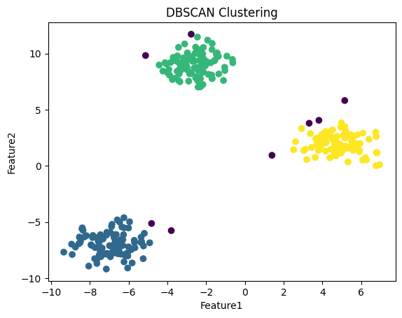
DBSCAN groups data points based on density of neighboring points.
It identifies dense regions as clusters and labels sparse points as noise or outliers.
Unlike K-Means, DBSCAN does not require specifying the number of clusters.

